Slide 1


Ronnie Li
May 15, 2024

Slide 2

Outline
Executive Summary
Introduction
Methodology
Results
Conclusion
Appendix

Slide 3
Executive Summary
SpaceY dedicates billions of dollars each year to improving its rockets’ efficiency, design, and mission success rate. Thus, the ability to predict whether a rocket will land successfully is of paramount importance to the company. However, machine learning methods to predict landing success have not been explored to our knowledge, and they can be a valuable, cost-effective tool for the company. In this report, we retrieved publicly available data from SpaceX’s Falcon 9 launch missions using both web scraping methods and application programming interface (API) methods. After performing exploratory data analysis and identifying the most relevant features, we trained a machine learning classifier to predict whether the Falcon 9 rocket would land successfully. Out of four tested models, we observed that a decision tree classifier achieved the best performance on a held-out test dataset. The chosen machine learning model demonstrates the power of computationally predicting landing success, and it serves as a valuable tool for the company to determine how to optimize their rockets.

Slide 4
Introduction
Background
SpaceY is an aspiring competitor of SpaceX, which is spearheaded by CEO Elon Musk. One of the SpaceX’s latest rockets is the Falcon 9, which has already been tested in multiple scenarios. Since direct physical testing of the Falcon 9 is extremely costly and labor-intensive, it would be more efficient to computationally determine whether a rocket launch would land successfully.
Objective
The objective of this report is to evaluate the competitiveness of SpaceY with SpaceX by using machine learning to predict whether a landing would occur successfully. In doing so, the model would provide insights into which aspects (features) are important for landing success, potentially driving down costs of testing the rocket in the future.

Slide 5

Section 1

Slide 6
Methodology
Data collection
Data from SpaceX were obtained from two sources:
SpaceX API: https://api.spacexdata.com/v4/rockets/
Web scraping: https://en.wikipedia.org/wiki/List_of_Falcon_9_and_Falcon_Heavy_launches
Data wrangling
We added a “class” label to denote the actual landing outcome of each launch.
We ensured that there were no missing values in the dataset. For all missing values, we imputed them using the mean of the feature.
Exploratory data analysis (EDA) using visualization and SQL
We performed EDA using SQL, and then we performed data visualization using the matplotlib and seaborn Python libraries.
Interactive visual analytics using Folium and Plotly Dash
Folium allowed us to create geographical maps of launch sites.
Dash allowed for the development of interactive visual dashboards, including pie charts and sliders.
Predictive analysis using classification models
We tested a variety of classification models, including decision tree, K nearest neighbors, support vector machine, and logistic regression.
How to build, tune, evaluate classification models
We used grid search combined with cross validation and train-test-split to determine the optimal model.

Slide 7
Data Collection
We obtained datasets from two sources:
SpaceX API: https://api.spacexdata.com/v4/rockets/
Wikipedia: https://en.wikipedia.org/wiki/List_of_Falcon_9_and_Falcon_Heavy_launches
The SpaceX API data were obtained using API calls, while the Wikipedia data were scraped from the web using the BeautifulSoup Python library.

Slide 8
Data Collection – SpaceX API
Send GET request to SpaceX API
SpaceX offers a public API from which data can be sourced and then utilized. This API was used according to the flowchart to the right.
GitHub notebook: https://github.com/ronnieli0114/IBMDataScience/blob/main/code/01_DataCollectionAPI.ipynb
Parse the SpaceX launch data results from the response
Filter the data to only include the Falcon 9 launches
Deal with missing values by substituting the mean

Slide 9
Data Collection - Scraping
Request the Falcon 9 Launch Wikipedia page
Wikipedia also hosts information about some past SpaceX launches. This data can be scraped from the web using Python. Data were scraped using the BeautifulSoup Python package and saved locally. See the flowchart to the right for the workflow.
GitHub notebook: https://github.com/ronnieli0114/IBMDataScience/blob/main/code/01_DataCollectionWebScraping.ipynb
Extract all column (variable) names from the HTML table header
Create a pandas DataFrame by parsing the HTML tables

Slide 10
Data Wrangling
Initially, some exploratory data analysis (EDA) was performed on the raw dataset. For example, we calculated the launches per site, occurrences of each orbit, and occurrences of each mission outcome for each orbit type.
Finally, we created the landing outcome “Class” label from the “Outcome” column.
GitHub notebook: https://github.com/ronnieli0114/IBMDataScience/blob/main/code/02_DataWrangling.ipynb
Exploratory Data Analysis (EDA)
Data summaries and value counts
Creation of landing outcome label

Slide 11
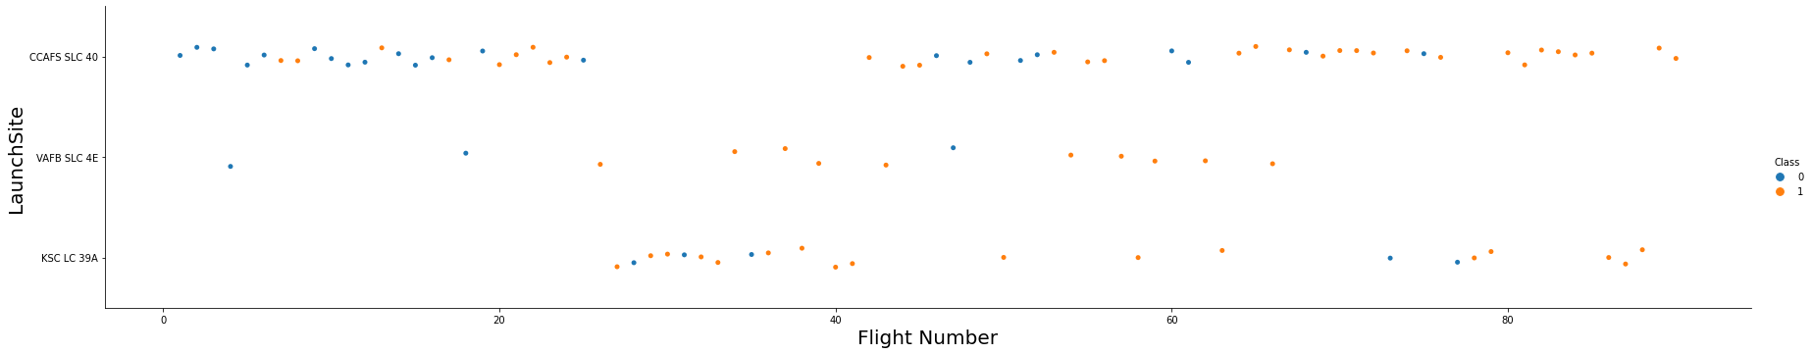
EDA with Data Visualization
To explore the relationships between variables, we used scatterplots as well as bar plots. For example, we plotted launch site by flight number as a scatterplot in the chart below, and then we color-coded the dots by the landing outcome (“class”).
GitHub notebook: https://github.com/ronnieli0114/IBMDataScience/blob/main/code/03_EDA_visualization.ipynb

Slide 12
EDA with SQL
The following SQL queries were performed:
Names of the unique launch sites in the SpaceX missions
Top 5 launch sites whose name began with the string “CCA”
Total payload mass carried by boosters launched by NASA (CRS)
Average payload mass carried by booster version F9 v1.1
Date when the first successful landing outcome on ground was achieved
Names of the boosters that had success in drone ships and had payload masses between 4000 and 6000 kg
Total number of successful and failed mission outcomes
Names of the booster versions that carried the maximum payload mass
Failed landing outcomes in drone ship: their booster version sand launch site names in the year 2015
A ranked count of landing outcomes between the dates 2010-06-04 and 2017-03-20
GitHub notebook: https://github.com/ronnieli0114/IBMDataScience/blob/main/code/03_EDA.ipynb

Slide 13
Build an Interactive Map with Folium
Markers, circles, lines, and marker clusters were used with Folium
Markers indicated noteworthy points like launch sites
Circles indicated highlighted areas around specific coordinates, like the NASA Johnson Space Center
Marker clusters indicated groups of coordinates, like launches in a launch site
Lines were used to calculate the distance between two coordinates.
GitHub notebook: https://github.com/ronnieli0114/IBMDataScience/blob/main/code/04_InteractiveFolium.ipynb

Slide 14
Build a Dashboard with Plotly Dash
The following graphs and plots were used to visualize the data in Plotly Dash:
Percentage of launches by site
Percentage of success for a given site
Payload ranges
These plots allowed us to quickly analyze the relationship between payload and launch site, helping us identify the optimal place to launch depending on the payload.
GitHub notebook: https://github.com/ronnieli0114/IBMDataScience/blob/main/code/05_PlotlyDash.py

Slide 15
Predictive Analysis (Classification)
We tested and compared four classification models:
Logistic regression
Support vector machine
Decision tree
K nearest neighbors
We implemented train_test_split to ensure that our training and testing sets were independent of each other. We also used feature scaling, grid search to find the best parameters, and cross validation scoring to prevent model overfitting.
GitHub notebook: https://github.com/ronnieli0114/IBMDataScience/blob/main/code/06_MachineLearningPrediction.ipynb

Slide 16
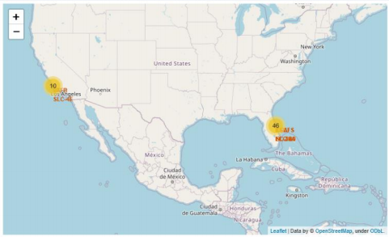
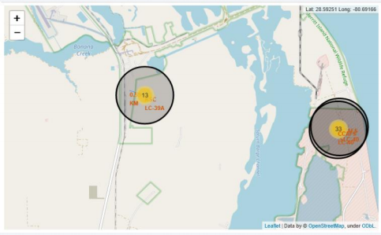
Results
Exploratory data analysis results
SpaceX uses a total of 4 different launch sites
The first launches were done close to SpaceX itself and NASA
The first successful landing outcome happened in 2015, five years after the first launch
Many Falcon 9 booster versions were successful in landing despite having payloads above the average mass
Almost 100% of mission outcomes were successful
Two booster versions failed at landing in drone ships in 2015: F9 v1.1 B1012 and F9 v1.1 B1015
The number of successful landing outcomes increased with time
Interactive analytics
Most launches occurred at East Coast launch sites
Launch sites are in safe zones, near the water, and next to stable infrastructure.
Predictive analysis
Decision Tree classifier was the best model to predict successful landings, achieving over 90% accuracy on the test dataset.

Slide 17

Section 2

Slide 18
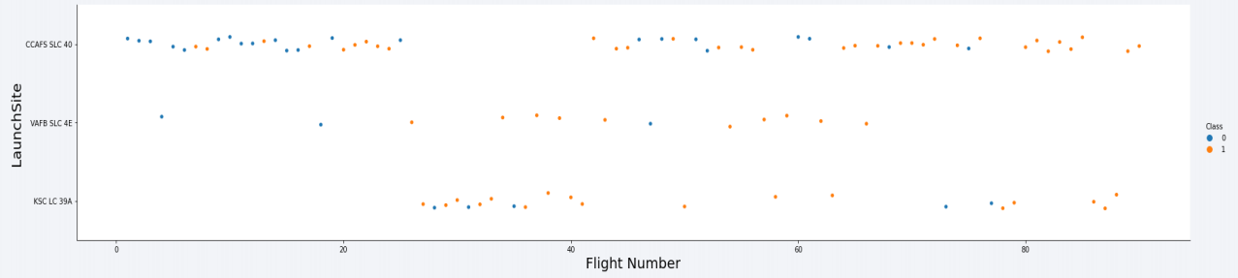
Flight Number vs. Launch Site
According to this plot, the best launch site was CCAF5 SLC 40, where most of the recent launches were successful. This is followed by VAFB SLC 4E and finally KSC LC 39A.
It is also worthy to note that the general success rate improved over time.

Slide 19
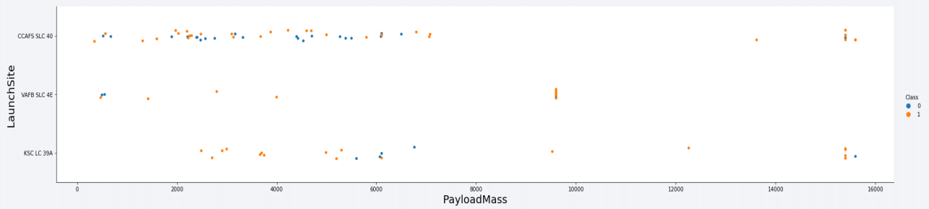
Payload vs. Launch Site
According to this plot, payloads over 9,000 kg have a very high success rate. However, payloads over 12,000 kg seem to be possible only on CCAFS SLC 40 and KSC LC 39A launch sites.
For payloads below 9,000 kg, the success rate is very mixed.

Slide 20
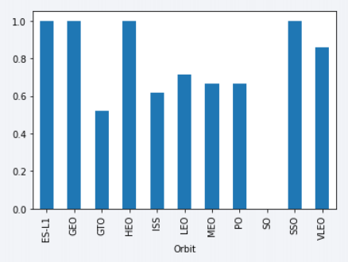
Success Rate vs. Orbit Type
The highest success rates occur in orbits:
ES-L1
GEO
HEO, and
SSO
These orbits have a 100% success rate.
The orbit with the lowest success rate is GTO.

Slide 21
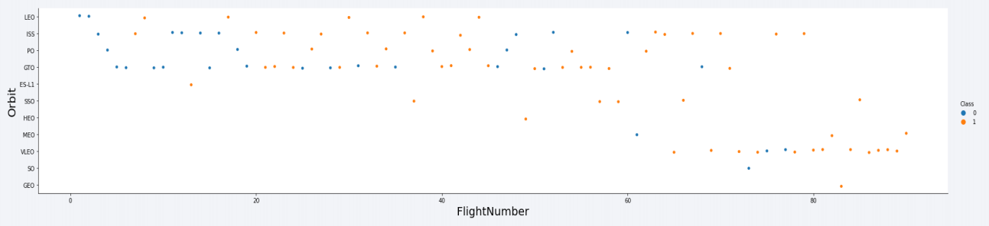
Flight Number vs. Orbit Type
This plot suggests that the success rate to all orbits improved over time.
VLEO orbit seems to be a new business opportunity due to the recent increase of its use.

Slide 22
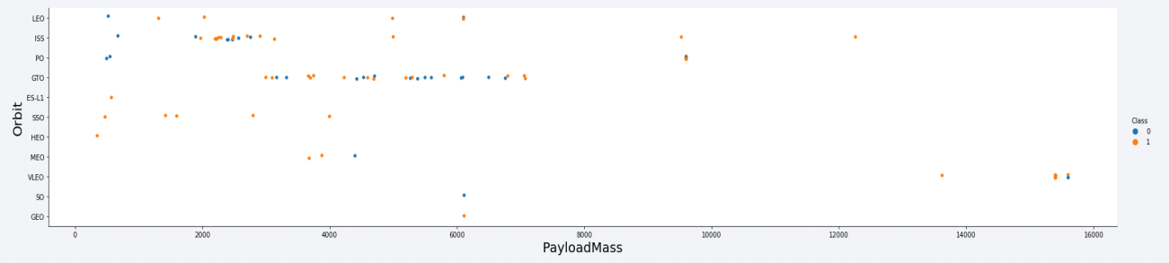
Payload vs. Orbit Type
For orbit GTO, there is no relationship between payload mass and success rate
The ISS orbit has the widest range of payload masses but still a very high rate of success
There are very few launches in the orbits SO and GEO

Slide 23
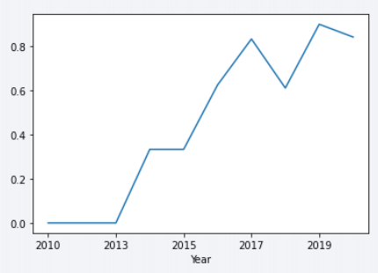
Launch Success Yearly Trend
The success rate was steadily increasing from 2013 until 2020, with a bit of a dip in 2018.
It seems that the first 3 years saw an especially high rise in success rates.
Success rate

Slide 24
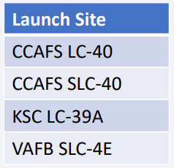
All Launch Site Names
There are four unique launch sites. This was obtained by an SQL query using the “SELECT DISTINCT” keywords.

Slide 25
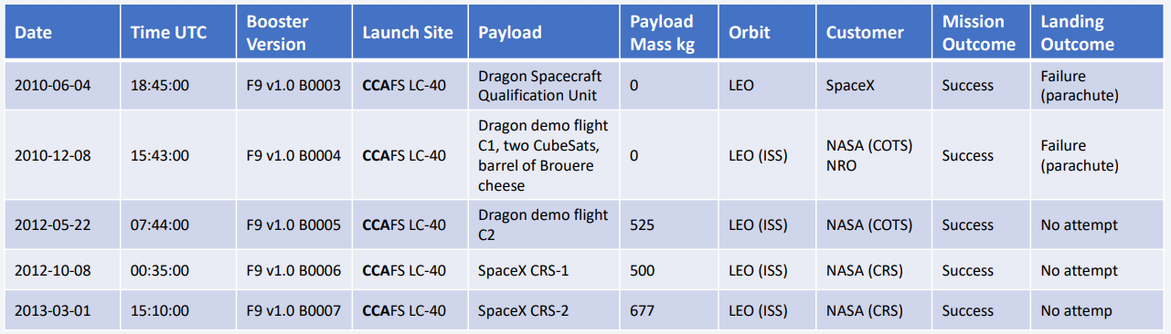
Launch Site Names Begin with 'CCA'
There are five records where the launch sites began with the string “CCA” for Cape Canaveral. These are samples of the launches from that site.
This query was done in SQL using the “LIKE” keyword.

Slide 26
Total Payload Mass
Total Payload (kg)
111,268
This is the total payload mass carried by boosters from NASA. This was obtained in SQL by summing all payloads whose codes contain CRS, which corresponds to NASA.

Slide 27
Average Payload Mass by F9 v1.1
Average Payload Mass by F9 v1.1 (kg)
2,928
This is the average payload mass carried by booster F1 v1.1. This was obtained in SQL by filtering records for F9 v1.1 and then averaging all payloads from those records.

Slide 28
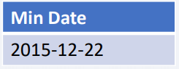
First Successful Ground Landing Date
This is the date of the first successful landing outcome on a ground pad. This query was done in SQL by filtering the landing outcomes for ground pad, and then obtaining the minimum value for the date from those records.

Slide 29
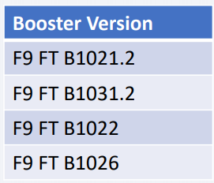
Successful Drone Ship Landing with Payload between 4000 and 6000
These are the boosters that have successfully landed on a drone ship and had payload masses between 4000 and 6000 kg.
This query was done in SQL by selecting the distinct booster versions using the payload mass filter above, which utilized the keyword BETWEEN.

Slide 30
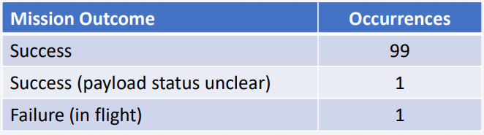
Total Number of Successful and Failure Mission Outcomes
These are the unique mission outcomes and how many times they occurred. We grouped mission outcomes and counted records for each group using SQL.
According to this table, most of the mission outcomes were successful.

Slide 31
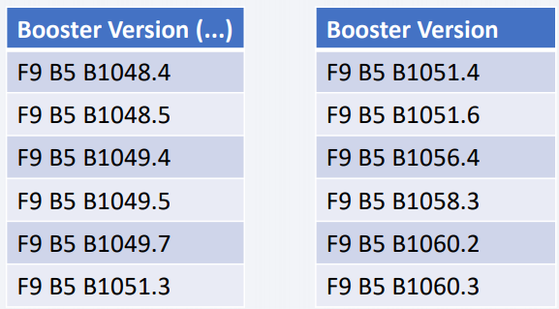
Boosters Carried Maximum Payload
These are the booster versions that carried the maximum payload. This was obtained in SQL using a sub-query and the MAX keyword.

Slide 32
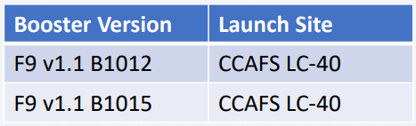
2015 Launch Records
These are the failed landing outcomes in drone ships, their booster versions, and their launch site names for the year 2015. There are only two occurrences in this list.

Slide 33
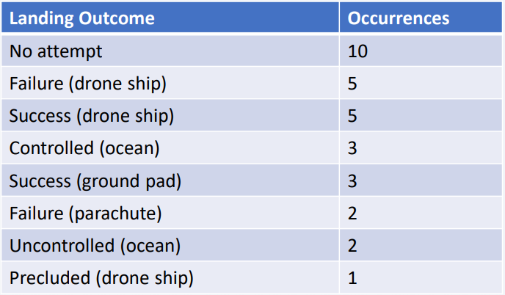
Rank Landing Outcomes Between 2010-06-04 and 2017-03-20
This is a ranking of landing outcomes between 2010-06-04 and 2017-03-20 in descending order. Most of the occurrences were “No attempt”.

Slide 34

Section 3

Slide 35
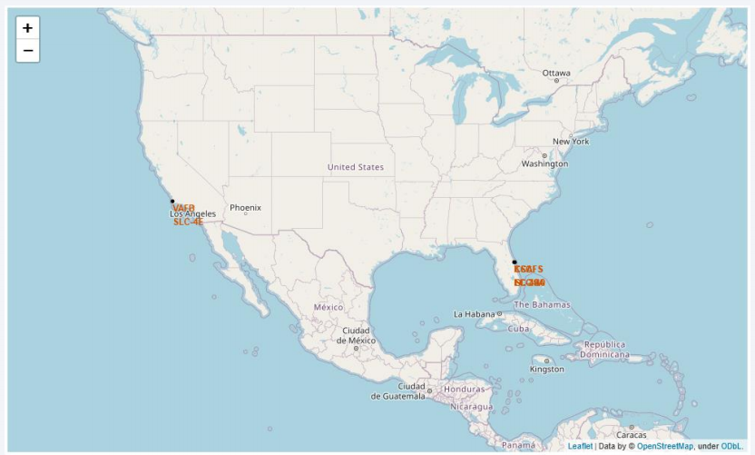
All launch sites
Most, if not all, launch sites appear to be in coastal regions, especially concentrated in Florida and California. This is probably due to safety reasons.

Slide 36
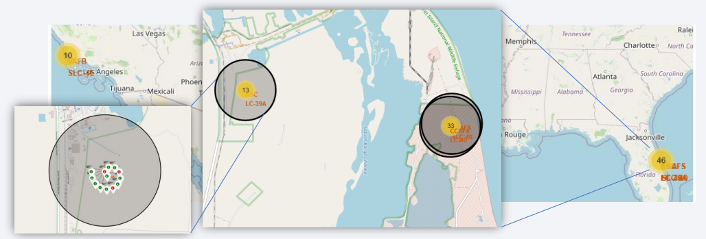
Landing outcomes by launch site
This is an example of the KSC LC-39A launch site outcomes. Green dots indicate successful landings; red dots indicate failed landings.

Slide 37
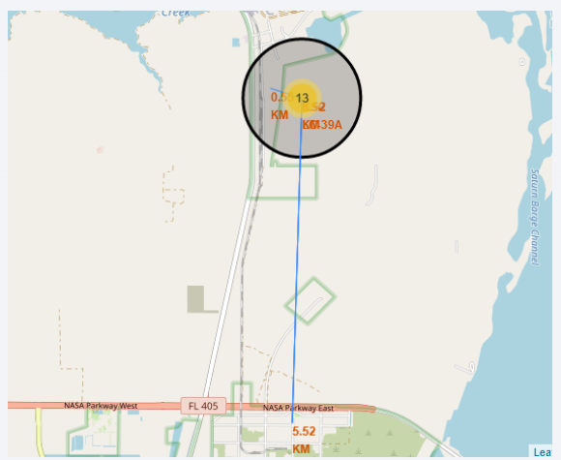
Safety and logistics
This is the location of the KSC LC-39A launch site. From visual examination, it makes logical sense that the launch site would be far away from people and civilization.
However, it is near railroads, which also makes sense since equipment and people need to be transported to and from the launch site.

Slide 38

Section 4

Slide 39
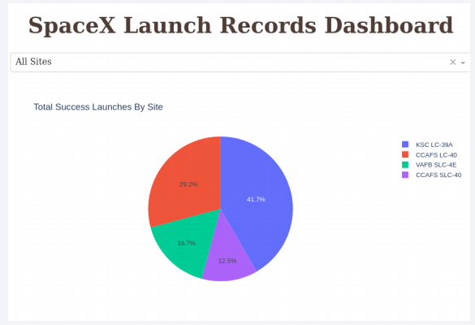
Successful launches by site
The site from which launches are done seems to play a very important role in determining the success or failure of the landing.
Most successful landings occurred at the launch site KSC LC-39A.

Slide 40
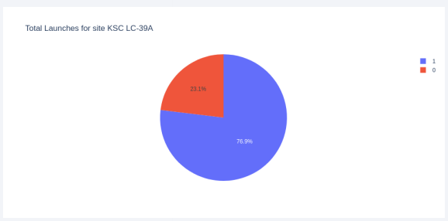
Landing success rate for KSC LC-39A
This site has the highest success rate, at 76.9%. Again, the location of the launch site seems primarily important for the prediction of the success or failure of the landing.

Slide 41
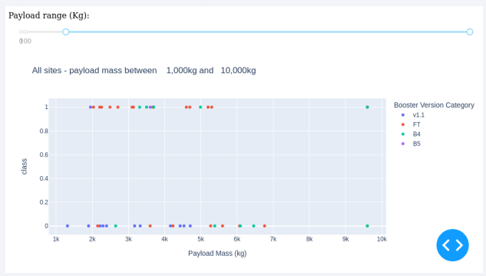
Payload vs. landing outcome
The most successful combination seems to be a payload under 6,000 kg coupled with an FT booster.

Slide 42

Section 5

Slide 43
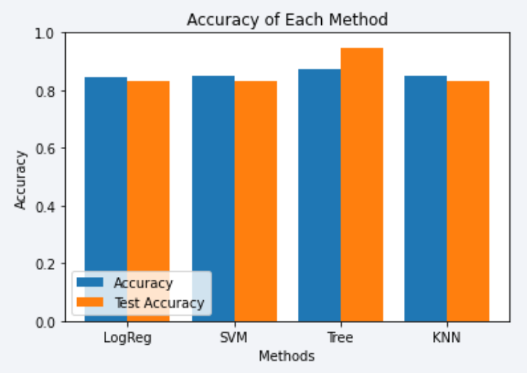
Classification Accuracy
We tested four different classifiers, using train-test split, grid search, and cross validation for model optimization.
The decision tree classifier had the highest accuracy on both the training and testing dataset, suggesting it did not overfit and is the best model to use.

Slide 44
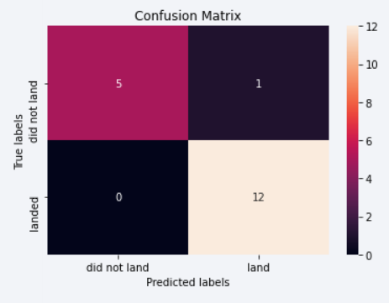
Confusion Matrix
This is the confusion matrix for the decision tree classifier.
As opposed to other classifiers, which had very high false positive rates, the decision tree classifier largely eliminated the false positives altogether, giving the best overall accuracy on the test dataset.

Slide 45
Conclusions
Exploratory data analysis is a crucial first step in examining relationships between variables.
The best launch site is KSC LC-39A as it had the highest proportion of successes.
Launches with payloads above 7,000 kg appear to be more successful and less risky.
Although most of the mission outcomes were successful, successful landing outcomes seemed to improve over time, suggesting that there is technological innovation and improvement to the processes and rockets themselves.
The decision tree classifier is very accurate at predicting which landings will be successful.

Slide 46
Appendix
It is important to set np.random.seed() to ensure rigor and reproducibility of code. For machine learning model initialization, it is also important to set the random_state parameter to be consistent each time.

Slide 47


